Slide 1

Green Pace
Security Policy Presentation
Developer: Brandon Canady
CS 405 • Project Two • October 2026
Notes:
Hello, I'm Brandon Canady, and this is my CS 405 security policy presentation for Green Pace. I'll explain how our coding standards, defensive controls, unit tests, and automated checks work together to reduce software security risks.

Slide 2

OVERVIEW: DEFENSE IN DEPTH
Purpose: Establish consistent secure C and C++ practices before code reaches production.
Layers: Input validation, code review, automated tests, access control, encryption, and monitoring.
Notes:
Green Pace needs consistent security policies because a small coding mistake can affect customer data or the availability of our services. The diagram shows defense in depth, where physical, network, host, endpoint, and application protections support one another. Our own policy applies the same idea to coding: we validate input, review code, run automated tests, limit access, protect data, and monitor for suspicious activity. No single safeguard is expected to catch every threat.

Slide 3
THREATS MATRIX
PROPOSED RISK SCALE
5 Critical (004, 005)
4 High (001, 002, 003, 008, 009, 010)
3 Medium (006, 007)
Scores weigh potential impact, likelihood, and effort.
Ratings are estimates, not observed attacks.
LIKELY / HIGH IMPACT SQL injection (004) Unsafe string bounds (003) | CRITICAL IMPACT Use-after-free (005) Potential data compromise / crash
HIGH PRIORITY Overflow (002), conversions (001) Container (008), null (009), double delete (010) | MEDIUM PRIORITY Assertions (006) Exception escape (007)
Notes:
The threats matrix helps Green Pace decide which vulnerabilities to address first. SQL injection and use-after-free receive priority five because of their potential consequences for data or memory safety. Integer errors, unsafe indexes, and pointer problems are priority four. Assertion and exception issues are priority three. These are planning estimates based on likelihood, impact, and repair effort, not measured breach frequencies. We can use compiler warnings, Cppcheck, and automated tests to help detect relevant weaknesses earlier.

Slide 4
10 PRINCIPLES
1. Validate input → 001, 002, 003, 004, 008, 009
2. Heed warnings → 001, 002, 006
3. Design for security → 005, 007, 010
4. Keep design simple → 003, 005, 006, 007, 009, 010
5. Default deny → 004
6. Least privilege → 004
7. Sanitize outbound data → 004
8. Defense in depth → 002, 004, 005, 007–010
9. Quality assurance → 001–003, 005–010
10. Secure coding baseline → 001, 003, 005, 006, 008, 010
Numbered references correspond to standards STD-001-CPP through STD-010-CPP.
Notes:
These ten principles guide how Green Pace writes and reviews software. Each one maps to specific coding standards. For example, validating input supports safe conversions, string boundaries, and SQL parameterization. Defense in depth connects several standards so a mistake is less likely to become a serious incident. This alignment helps developers turn broad security expectations into practices they can verify in code.

Slide 5
CODING STANDARDS
PRIORITY 5 — CRITICAL
PRIORITY 4 — HIGH (CONT.)
STD-004 Parameterize SQL queries
STD-005 Prevent use-after-free
STD-008 Check container indexes
STD-009 Validate pointer access
STD-010 Prevent double deletion
PRIORITY 4 — HIGH
PRIORITY 3 — MEDIUM
STD-001 Safe integer conversions
STD-002 Prevent signed overflow
STD-003 Check string boundaries
STD-006 Avoid assertion side effects
STD-007 Handle exceptions safely
Priority considers impact, likelihood, and remediation effort—not the standard ID.
Notes:
Green Pace has ten coding standards, ranked by security risk. The two most urgent are parameterized SQL queries and prevention of use-after-free, because those issues can threaten sensitive data and memory safety. Six high-priority standards address integer handling, string and container bounds, null pointers, and double deletion. The remaining standards focus on assertions and exceptions. The order considers impact, likelihood, and repair effort, so teams can work on the highest-risk problems first.

Slide 6
ENCRYPTION POLICIES
IN FLIGHT — Protect data moving across networks
Use TLS 1.3 where supported for browser, API, database, and administrator connections; verify certificates.
AT REST — Protect stored information
Apply approved AES-256 encryption to databases, backups, and devices; manage and rotate keys securely.
IN USE — Limit exposure while software processes data
Use least privilege, process isolation, and short-lived plaintext; consider confidential computing when warranted.
Notes:
Encryption needs to protect data in three situations. In flight means data moving across the network, so we use encrypted TLS connections and verify certificates. At rest means information stored in databases, devices, and backups, which Green Pace should protect with approved encryption and secure key management. In use means data being processed in memory. Ordinary encryption at rest does not protect active plaintext, so we limit access, isolate processes, and reduce how long sensitive data remains exposed.

Slide 7
TRIPLE-A POLICIES
AUTHENTICATION — Who are you?
Verify identities and require multifactor authentication for remote or privileged access.
AUTHORIZATION — What are you allowed to do?
Deny access by default; use roles, ownership checks, and the least privilege needed for each task.
ACCOUNTING — What happened?
Audit logins, permission changes, and sensitive transactions; protect logs and never record secrets.
Notes:
The Triple-A framework stands for authentication, authorization, and accounting. Authentication verifies who a user is, especially for privileged accounts. Authorization limits what that person can access, even after a successful login. Accounting records security-relevant activity, like permission changes or access to customer information. Together these controls make Green Pace more resilient and help the team investigate incidents without exposing passwords or other secrets in logs.

Slide 8
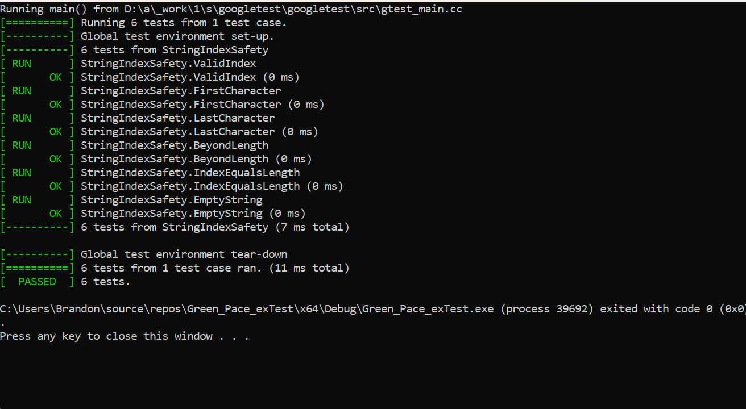
Unit Testing
C++ string index safety • Google Test • STD-003-CPP
POSITIVE ✓ ValidIndex → 'a'
POSITIVE ✓ FirstCharacter → 'P'
POSITIVE ✓ LastCharacter → 'e'
NEGATIVE ✓ BeyondLength → throws
NEGATIVE ✓ IndexEqualsLength → throws
NEGATIVE ✓ EmptyString → throws
ACTUAL RESULT: 6 PASSED • 0 FAILED • 11 ms
Next: Add more boundary cases, fuzz inputs, and run Google Test automatically in CI.
Notes:
For unit testing, I focused on out-of-range string indexing in C++. I used the Google Test framework with std::string's bounds-checked at method. Three positive cases checked valid characters in the word Pace. Three negative cases checked invalid indexes, including the end of the string and an empty string, expecting an out-of-range exception. I actually ran the suite in Visual Studio: all six tests passed with zero failures in eleven milliseconds. Next I would test additional boundaries and run these tests automatically whenever code changes. These results verify the particular checks we tested; they do not prove that every possible memory vulnerability has been removed.

Slide 9

AUTOMATION SUMMARY
Build: compiler and Cppcheck • Verify: Google Test and sanitizers • Operate: logs and alerts
Notes:
This diagram shows the DevSecOps cycle, from pre-production through production and back again. During planning and design, we assess risks and choose secure approaches. In the build stage, compiler warnings and static analysis can identify coding issues. During verification, automated tests and sanitizers check the behavior of the software before release. After deployment, logs and alerting help us detect and respond to threats. For Green Pace, this means security continues throughout development rather than waiting until there is a problem.

Slide 10
TOOLS | C++ SSDLC PIPELINE
Security checks start in design and continue through production.
01
02
03
04
PLAN / DESIGN
›
BUILD / COMPILE
›
VERIFY / TEST
›
RELEASE / PROD
BEFORE CODE
STATIC CHECKS
RUNTIME CHECKS
CONTINUOUS DEFENSE
Threat modeling
Compiler warnings
Google Test
Release gates
Entry points & trust boundaries
-Wall, -Wextra, -Werror
Unit & integration tests
Block critical findings
Design reviews
Static analysis
Sanitizers
Monitor & respond
Least privilege & architecture
Cppcheck & Clang-Tidy
ASan memory; UBSan behavior
Logs, alerts, incidents
Compiler example (GCC/Clang): -Wall -Wextra -Wpedantic -Werror • Continuous feedback to planning
Notes:
This slide shows how Green Pace can build security into the complete C++ software development lifecycle. First, during planning and design, we identify possible attack paths, entry points, and trust boundaries. Secure design reviews also help make sure we're following principles like least privilege, before anyone starts writing code. Next comes the build and compile stage. Here, compiler warnings help catch suspicious code early. With GCC or Clang, flags like dash Wall, dash W extra, dash W pedantic, and dash W error can make warnings much harder to ignore. Cppcheck and Clang-Tidy add another layer by scanning source code for bugs and risky C++ patterns. Then, in verification and testing, Google Test checks that the program behaves as expected. AddressSanitizer helps detect memory mistakes, and UndefinedBehaviorSanitizer can find certain types of undefined behavior. Finally, before release, security gates can hold back builds with serious findings. Once Green Pace's software is running, logging, alerts, and incident response keep the protection going. The main idea is that security should follow the code from its first design review all the way into production.

Slide 11
RISKS AND BENEFITS
PROBLEM
SOLUTION — ACT NOW
SQL injection could expose customer records. Memory errors could cause crashes, corruption, or outages.
Use SQL parameters, safer memory practices, reviews, Cppcheck, and Google Test before release.
BENEFITS OF ACTING EARLY
RISKS OF WAITING
Lower breach and outage exposure, fewer expensive late fixes, better reliability, and customer confidence.
Defects reach production, raising response costs, business disruption, and recovery time.
Trade-off: scanning adds time and false positives; use risk-based gates and human review.
Notes:
Now, let's talk about the risks and benefits of putting Green Pace's security policy into action. One of the biggest concerns is that coding vulnerabilities, like SQL injection or memory errors, could expose customer information or cause unexpected system failures. By addressing these issues early, Green Pace can reduce potential security incidents, lower repair costs, and build greater trust with its customers. But if we wait until something goes wrong, those vulnerabilities could reach production, where they're often more expensive to fix. Security tools also have trade-offs, like additional testing time, false positives, and training. Even so, the long-term benefits make early security checks a sensible investment.

Slide 12
RECOMMENDATIONS
CURRENT POLICY GAPS
No confirmed automated release gates, incomplete test-coverage metrics, and no established scan baseline.
PRACTICAL IMPROVEMENTS
Add CI security checks, memory sanitizers, dependency reviews, and targeted fuzz testing.
MEASURE PROGRESS
Track finding severity, time-to-fix, repeated issues, and expiring risk exceptions.
PLAN FOR NEW THREATS
Revisit standards after major changes or incidents; keep developer training current.
Notes:
Even with a policy in place, Green Pace still has some gaps. We need evidence that our automated checks consistently run before release, broader measures of test coverage, and a baseline for tracking scan findings. I recommend integrating security checks into continuous integration, using sanitizers and targeted fuzzing, and reviewing third-party dependencies. The team should track how quickly serious findings are resolved, then update security controls as applications, tools, and threats change.

Slide 13
CONCLUSIONS
Adopt the SEI CERT C++ coding standard as a core secure-code baseline.
Apply OWASP guidance for SQL injection prevention and application verification.
Use NIST's Secure Software Development Framework to govern CI/CD security activities.
Combine secure design, code review, tests, access controls, encryption, and monitoring.
Bottom line: Start security in design, and keep checking after deployment.
Notes:
To close, Green Pace should adopt established standards rather than relying only on individual developer habits. SEI CERT C++ provides guidance for safe C++ practices, OWASP helps prevent common application vulnerabilities, and NIST's Secure Software Development Framework supports disciplined development and release processes. Combining those practices with ongoing testing, encryption, access controls, and monitoring supports a stronger defense in depth. The big takeaway is simple: security starts during design, not at the end, and it continues after deployment.

Slide 14
REFERENCES
Carnegie Mellon University, Software Engineering Institute. (n.d.). SEI CERT C++ coding standard. https://wiki.sei.cmu.edu/confluence/display/cplusplus
OWASP Foundation. (n.d.). SQL injection prevention cheat sheet. https://cheatsheetseries.owasp.org/cheatsheets/SQL_Injection_Prevention_Cheat_Sheet.html
National Institute of Standards and Technology. (2022). Secure software development framework (NIST SP 800-218). https://doi.org/10.6028/NIST.SP.800-218
LLVM Project. (n.d.). AddressSanitizer. https://clang.llvm.org/docs/AddressSanitizer.html
Google. (n.d.). GoogleTest primer. https://google.github.io/googletest/primer.html
Notes:
These references support the secure coding practices, automated testing framework, and development standards discussed throughout the presentation.

